Slide 1
Food Hero Recipe Tour
Extension Service Family and Community Health SNAP-Ed Program, College of Public Health and Human Sciences
Notes:
Must be in Slide Master mode to swap out photos.

Slide 2
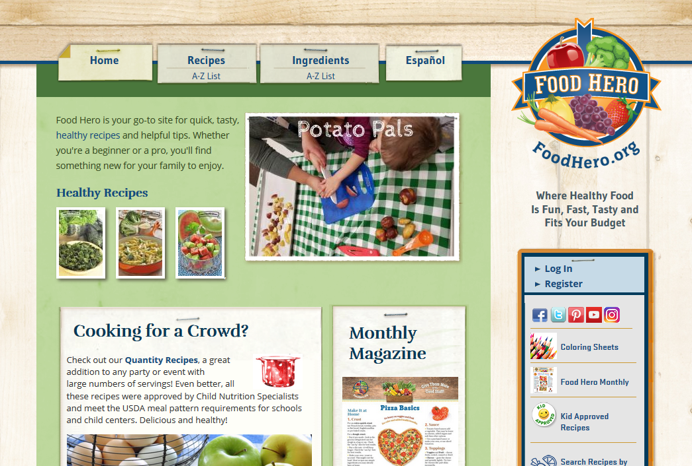
Food Hero Recipes Overview
Over 340 delicious and healthy, easy to prep, tested recipes
Use of low cost, common ingredients

Slide 3
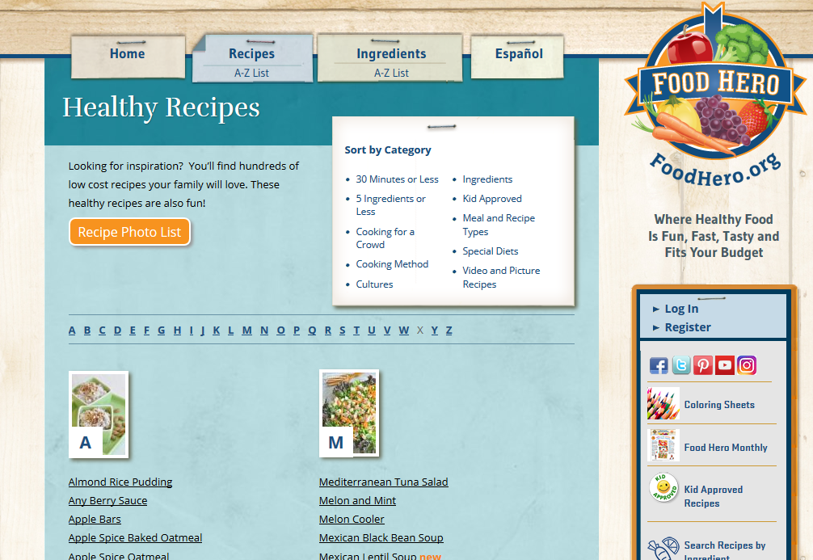
Food Hero Recipes – A to Z List

Slide 4
Food Hero Recipes – Sort by Main Ingredient

Slide 5
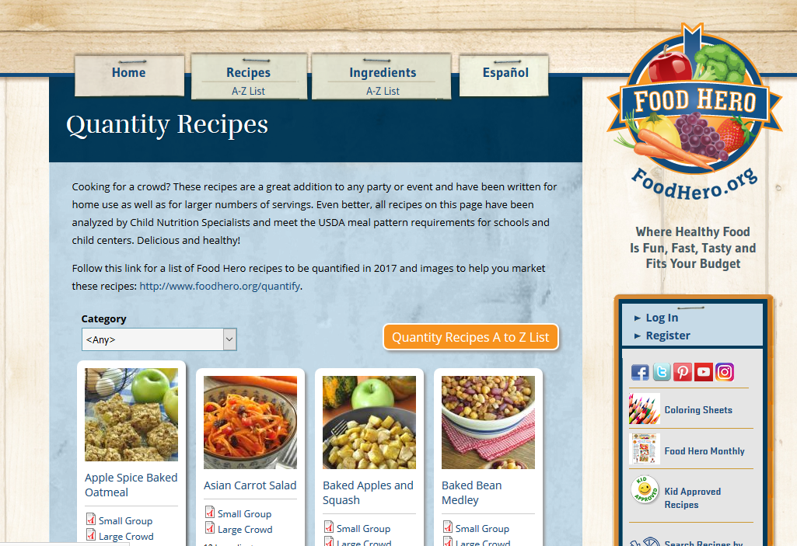
Food Hero – Quantified Recipes - Overview
70+ quantified recipes
Analyzed by Child Nutrition Specialists to meet the USDA meal pattern requirements for schools and child centers

Slide 6
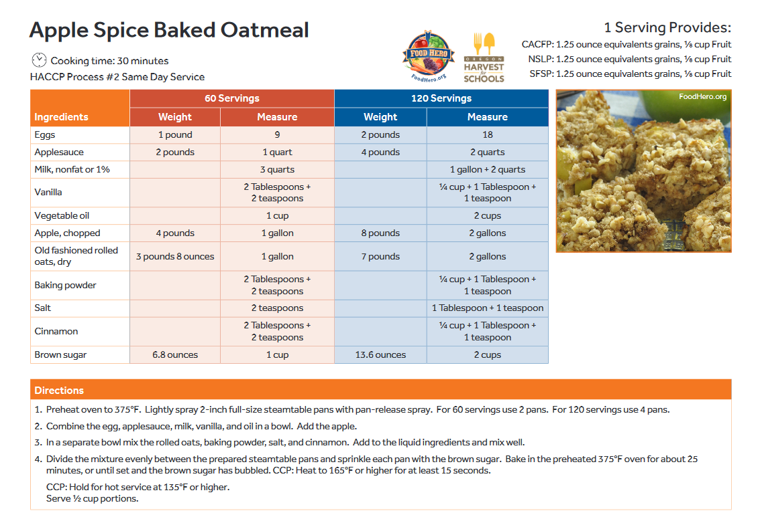
Food Hero – Quantified Recipes – PDF Example

Slide 7
Food Hero Recipes – Kid Approved

Slide 8
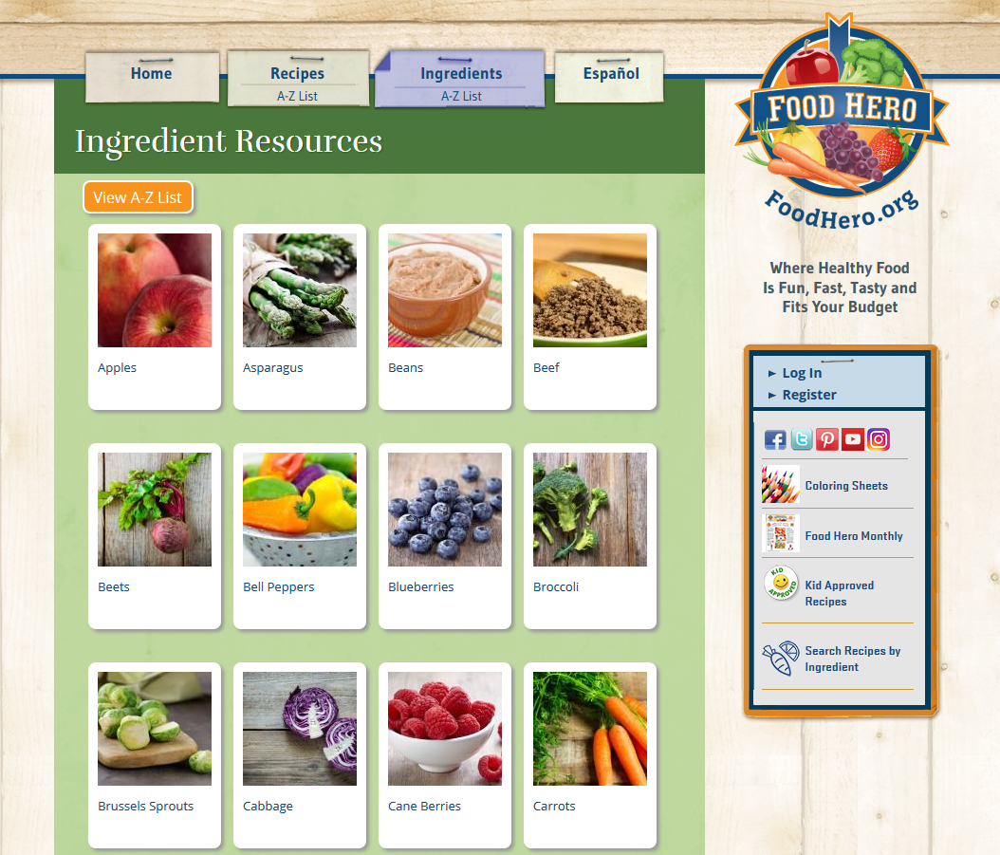
Food Hero – Ingredient Resources

Slide 9
More Ways to Connect with Food Hero Recipes

Slide 10
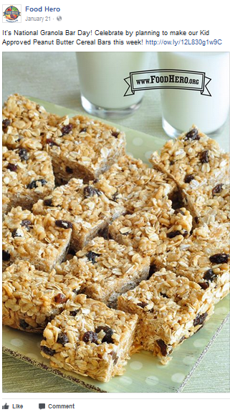
Food Hero Facebook Post Examples – Both are of Quantified Recipes

Slide 11
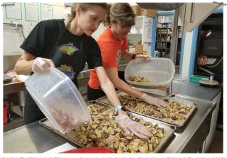
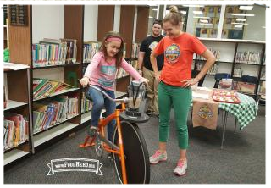
Questions?
Email: Food.Hero@OregonState.Edu

